Slide 1

Bitcoin Alpha Strategies
Alan Chi
Yazi Lin
Gurkanwar Singh
Huijie Zhao
Notes:
Alan Chi [qc2246]
Yazi Lin [yl3865]
Gurkanwar Singh [gs3006]
Huijie Zhao [hz2580]

Slide 2

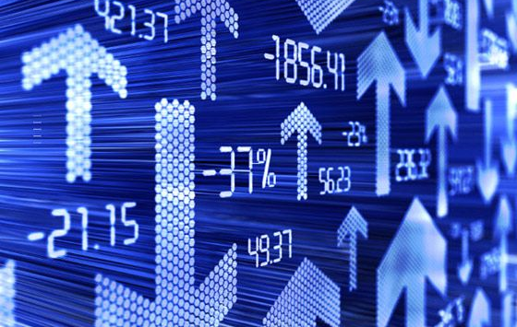
What’s The Problem
How does the public opinions affect trading price movement?
What is the trading strategy and the ultimate question of when to invest and when to short?
How do we optimize return while limit downside risk?

Slide 3
Methodologies
Data Cleaning, Merging
Sentiment Analysis
Pricing Strategy

Slide 4
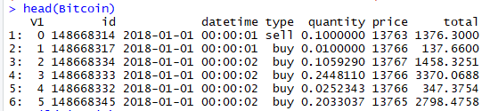




How’s The Dataset
2018 Q1 Bitcoin Trading Data by Tick
2018 Q1 Reddit Comments

Slide 5
Data Cleansing
Reddit-created_utc
Convert data into UTC date time
Bitcoin-Date Time
Group by minute
Combine Bitcoin and Reddit
Data join by UTC date time

Slide 6
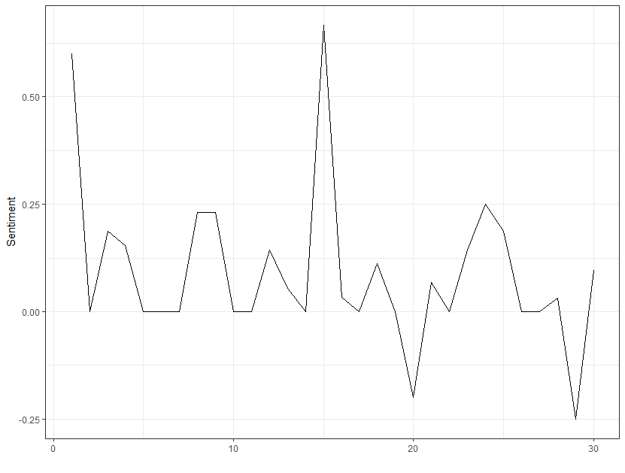
Sentiment Analysis
> redditsubset$signal <- (analyzeSentiment(redditsubset$body)$SentimentQDAP)

Slide 7
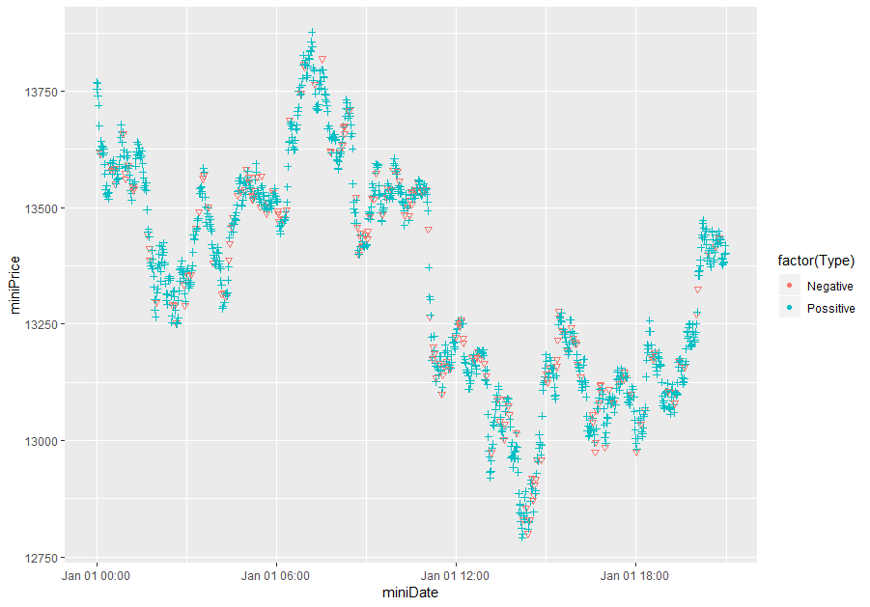
Human Behavior Insights

Slide 8
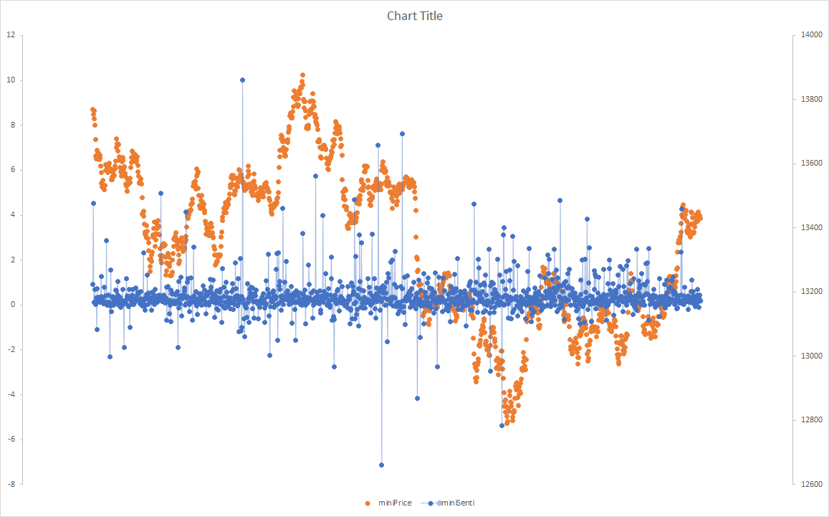
Lag Analysis and Trend Following

Slide 9
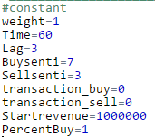

Trading Strategy
Buy now at sentiment >7, sell at time lag of 3 minutes
Sell now at sentiment<-3, time lag of 3 minutes
Starting @ $1M (1.49% transaction fee market rate)
7
-3

Slide 10
Q&A

